Slide 1
Introduction to the Arduino
Ryan Brock

Slide 2
About Me
Ryan Brock
Software Engineer – 14 Years
Purdue University – Computer Science
Motorola
Zebra Technologies

Slide 3
Contact
Twitter: @borq79
Email: borq79@gmail.com
Github Repo:
https://github.com/borq79/Cary-Area-Public-Library-Classes

Slide 4
Agenda
Intro (5 Minutes)
Quick Basics (10 Minutes)
Project 1 (15 Minutes)
Bring and LED to life
So What Just Happened? (15 Minutes)
Basic Circuit
What is an LED
Voltage / Current / Resistance
Project 2 (20 Minutes)
Introducing a button into the circuit
Project 3 (20 Minutes)
Reading the Temperature of the Room
Project 4 (25 Minutes)
Multicolor LEDs

Slide 5
Breadboard

Slide 6
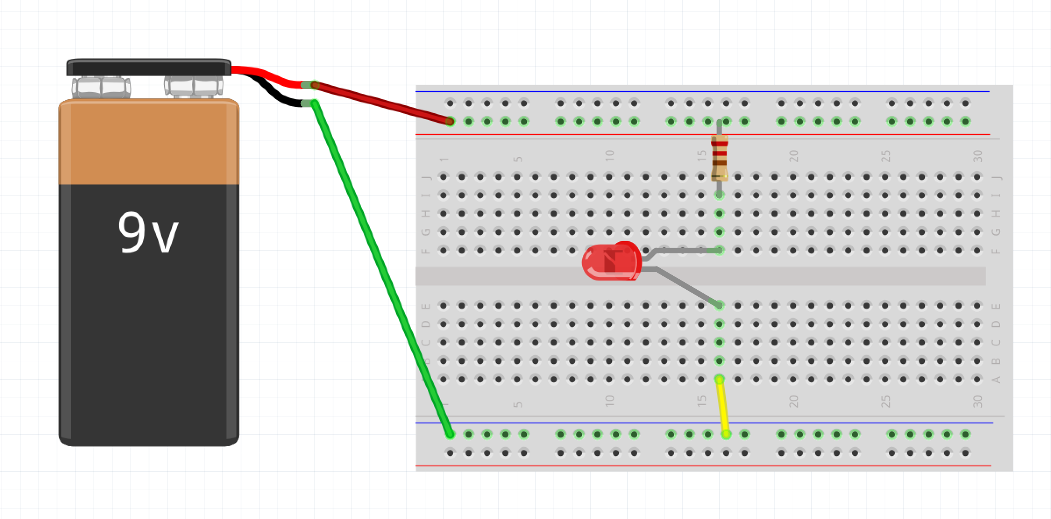
Wiring up a Circuit

Slide 7
Project 1 Parts List
Arduino
Breadboard
USB Cable
3 Male-Male wires
1 330 Ohm resistor
1 LED

Slide 8
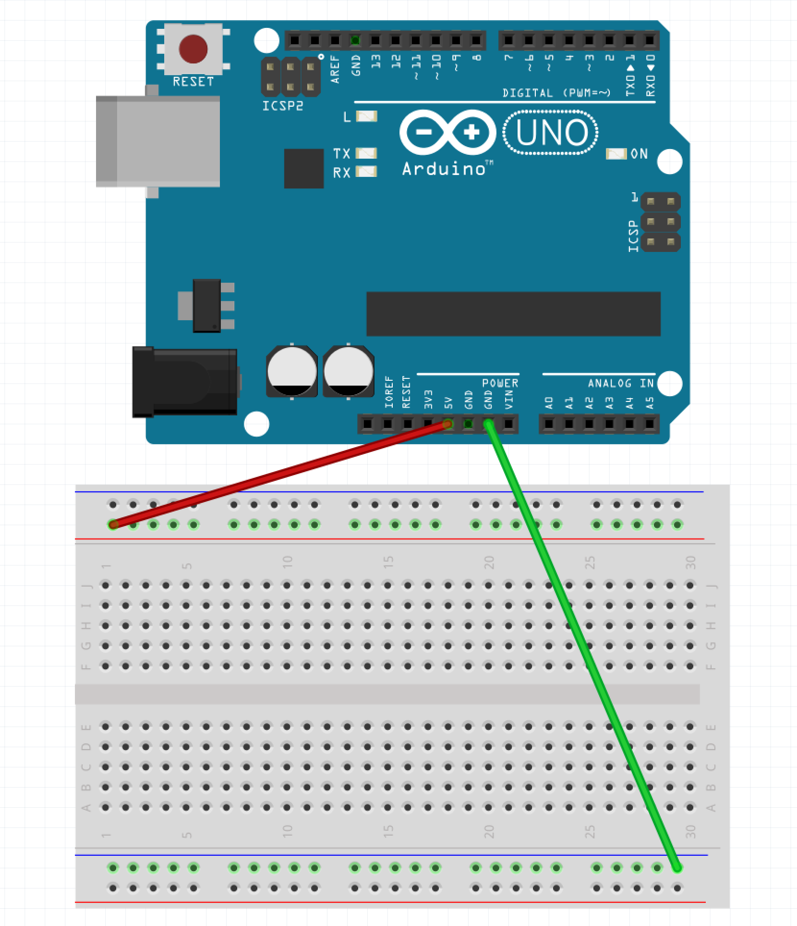
Step 1 – Wire up the Rails
Run wire from GND pin on Arduino to Blue Row on Breadboard
Run wire from 5V pin on Arduino to Red Row on Breadboard

Slide 9
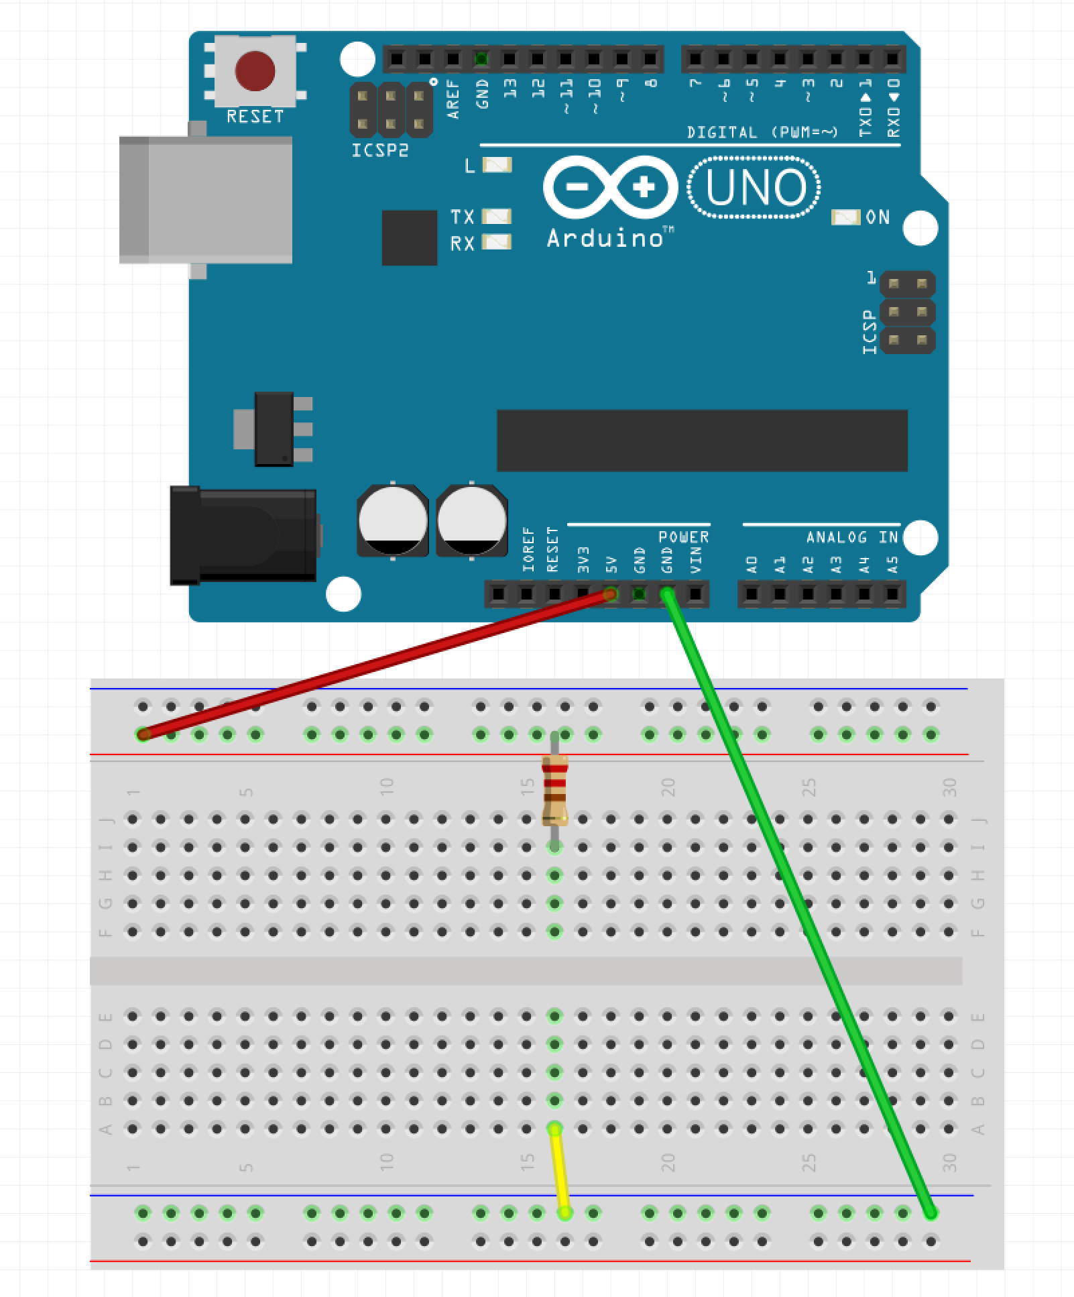
Step 2 – Place Resistor
Run wire from the Ground rail to A:16
Place one leg of resistor in the power rail and the other in I:16

Slide 10
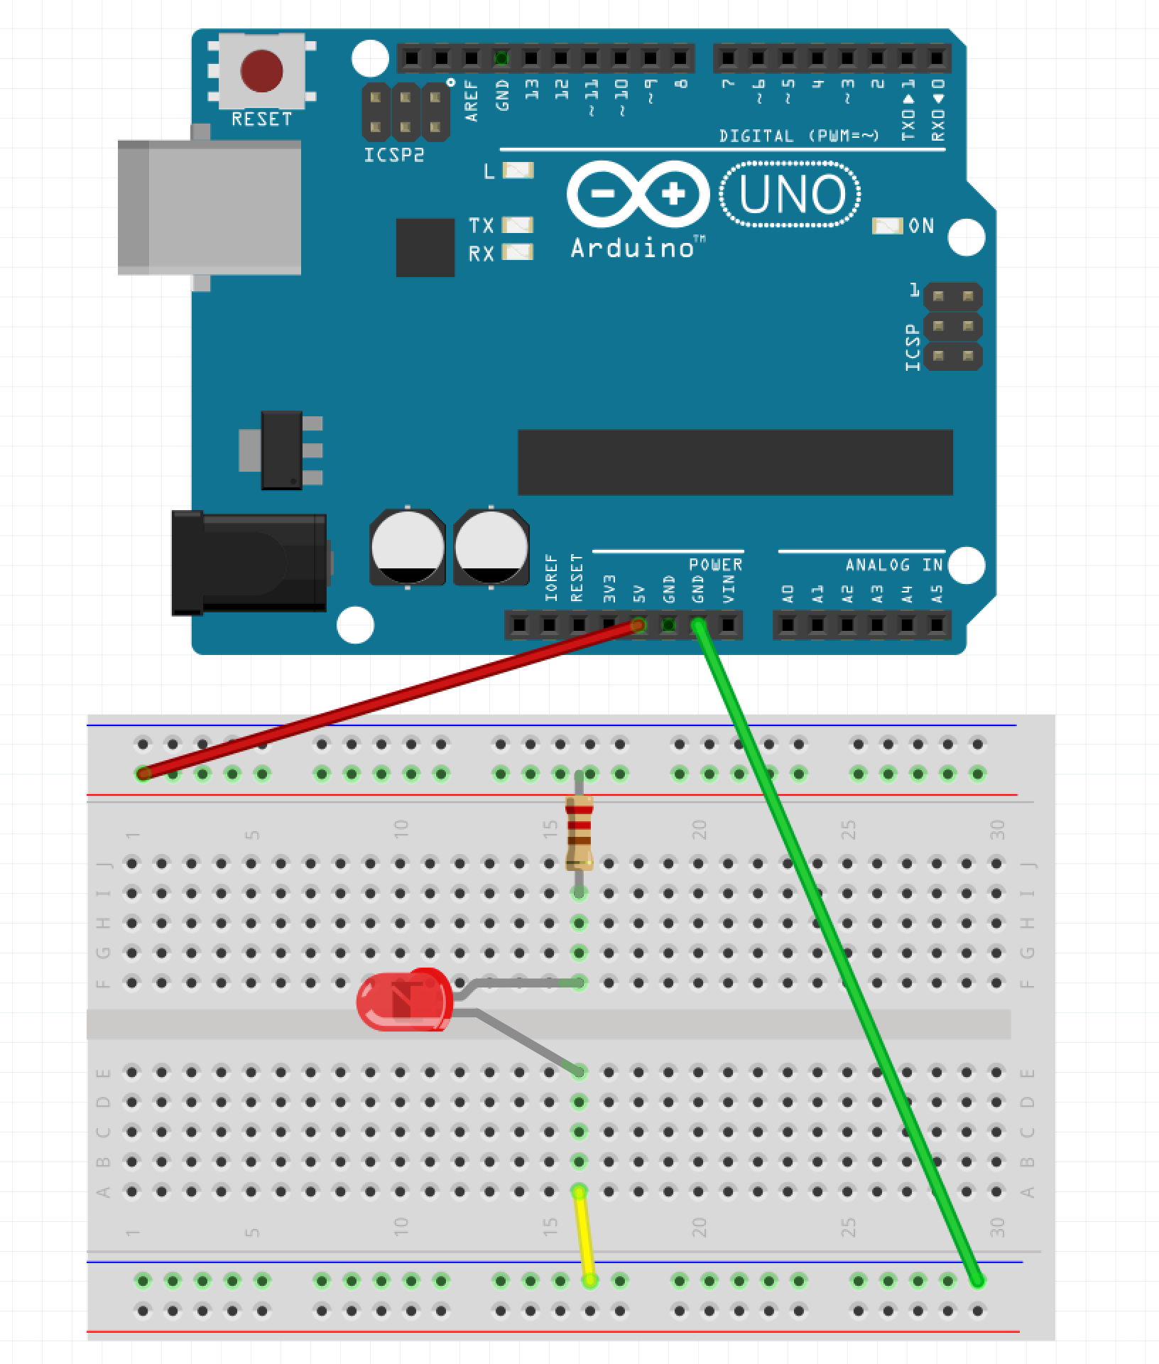
Step 3 – Place LED
Place the longer leg of the LED into F:16
Place the shorter leg of the LED into E:16

Slide 11
Step 4 – Apply Power
Plug the Arduino into the USB Cable
Plug the USB Cable into the PC

Slide 12
So What Just Happened?
Complete Circuit
Arduino acted like a battery
Resistor restricted current flow so LED isn’t damaged

Slide 13
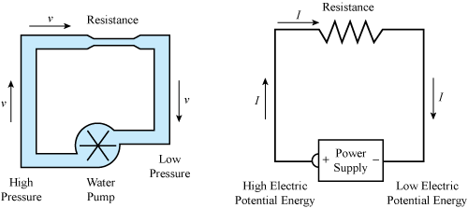
Water Analogy

Slide 14
LEDs

Slide 15
Why is one lead longer?

Slide 16
Project 2 Parts List
Arduino
Breadboard
USB Cable
3 Male-Male wires
1 330 Ohm resistor
1 LED
1 Button

Slide 17

Step 1 – Move the Wires
Make sure the USB Cable is not plugged into the PC
Move the wire plugged into GND on the Arudino from the Blue Row to J:25 on the breadboard
Move the wire plugged into 16:A from the Blue Row to A:25

Slide 18
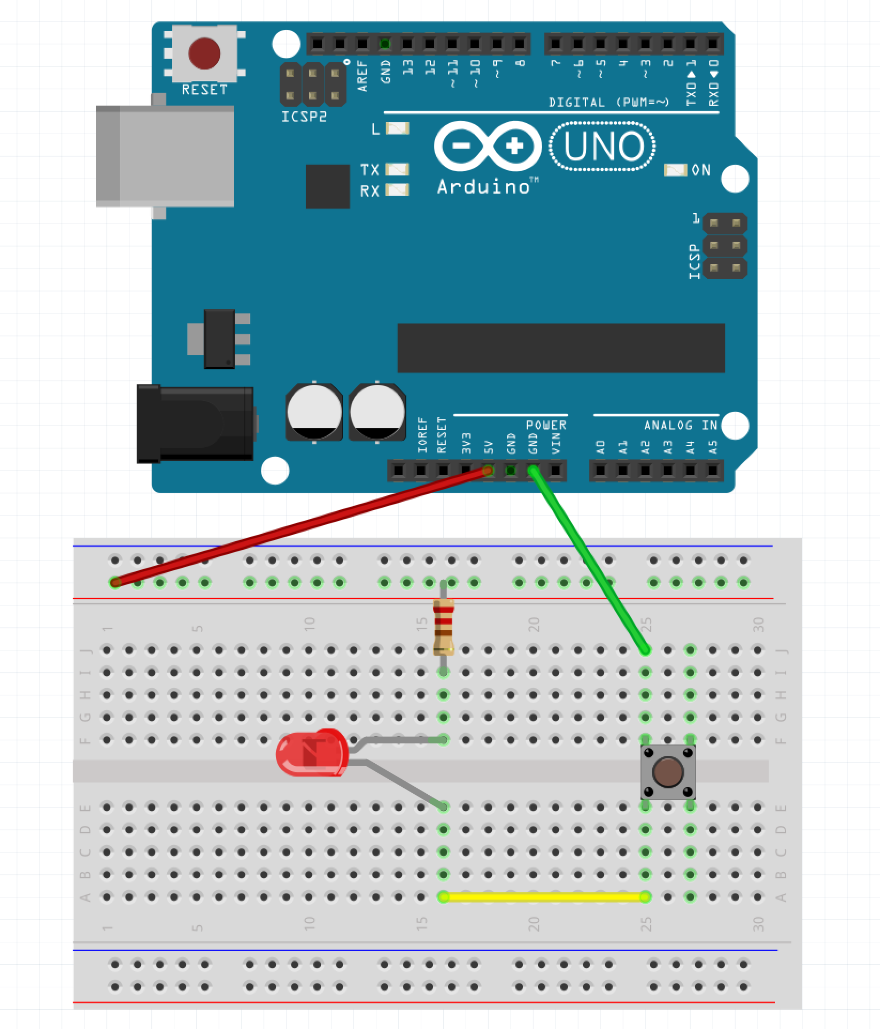
Step 2 – Place the Button
Place the button across the gap

Slide 19
Step 3 – Apply Power
Plug the Arduino into the USB Cable
Plug the USB Cable into the PC

Slide 20
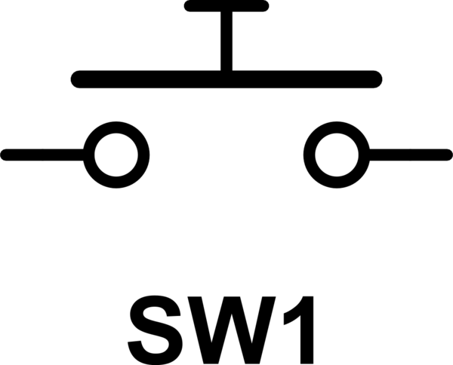
Button as a Switch

Slide 21
Project 3 - Let’s ’Read’ Something
The Arduino can ‘drive’ pins
The Arduino can also ‘read’ pins
Allows Arduino to ’read’ sensors, collect data, etc.

Slide 22
Project Parts List
Arduino
Breadboard
USB Cable
1 DHT11 Humidity / Temperature Sensor
3 Male-Female wires

Slide 23
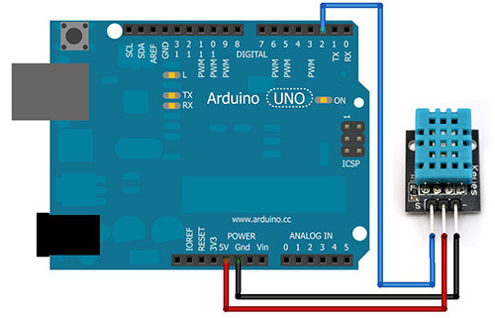
Step 1
Make sure the USB Cable is not plugged into the PC
Place a Male-Female connector running from the GND pin of the Arduino to the negative pin of the DHT11
Place a Male-Female connector running from the 5V pin of the Arduino to the middle pin of the DHT11
Place a Male-Female connector running from the 2 pin of the Arduino to the ‘S pin of the DHT11

Slide 24
Step 2 – Power the Arduino
Plug the Arduino into the USB Cable
Plug the USB Cable into the PC

Slide 25
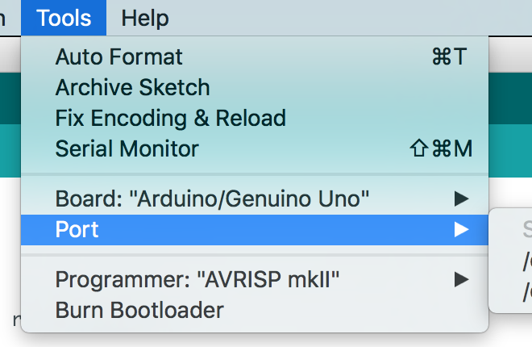
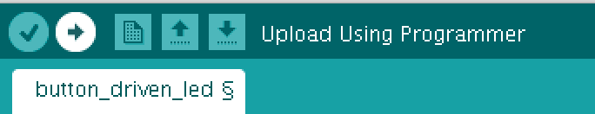
Step 3 – Program the Arduino
Open Sketch dht11.ino
Select Tools -> Port
Click the Upload Button

Slide 26
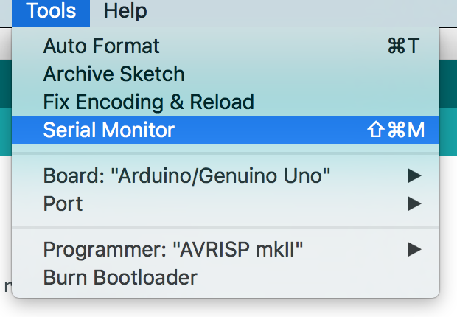
Step 4 – Open the Serial Monitor
Go to Tools and select ‘Serial Monitor’

Slide 27
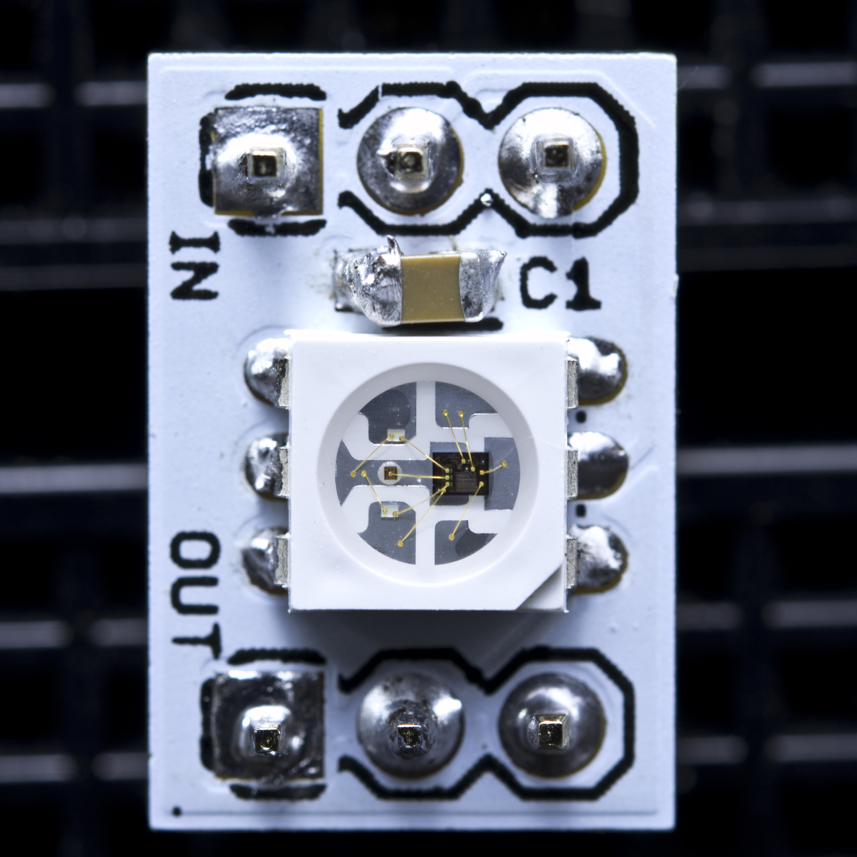
WS2811

Slide 28
Project 4 Parts List
Arduino
Breadboard
USB Cable
1 Neo Pixel Strip with 8 LEDs
1 1000F Capacitor (provided by Ryan)
1 10K Ohm resistor (in kit)
3 Male-Female wires (provided by Ryan)
3 Male-Male wires (in kit)

Slide 29
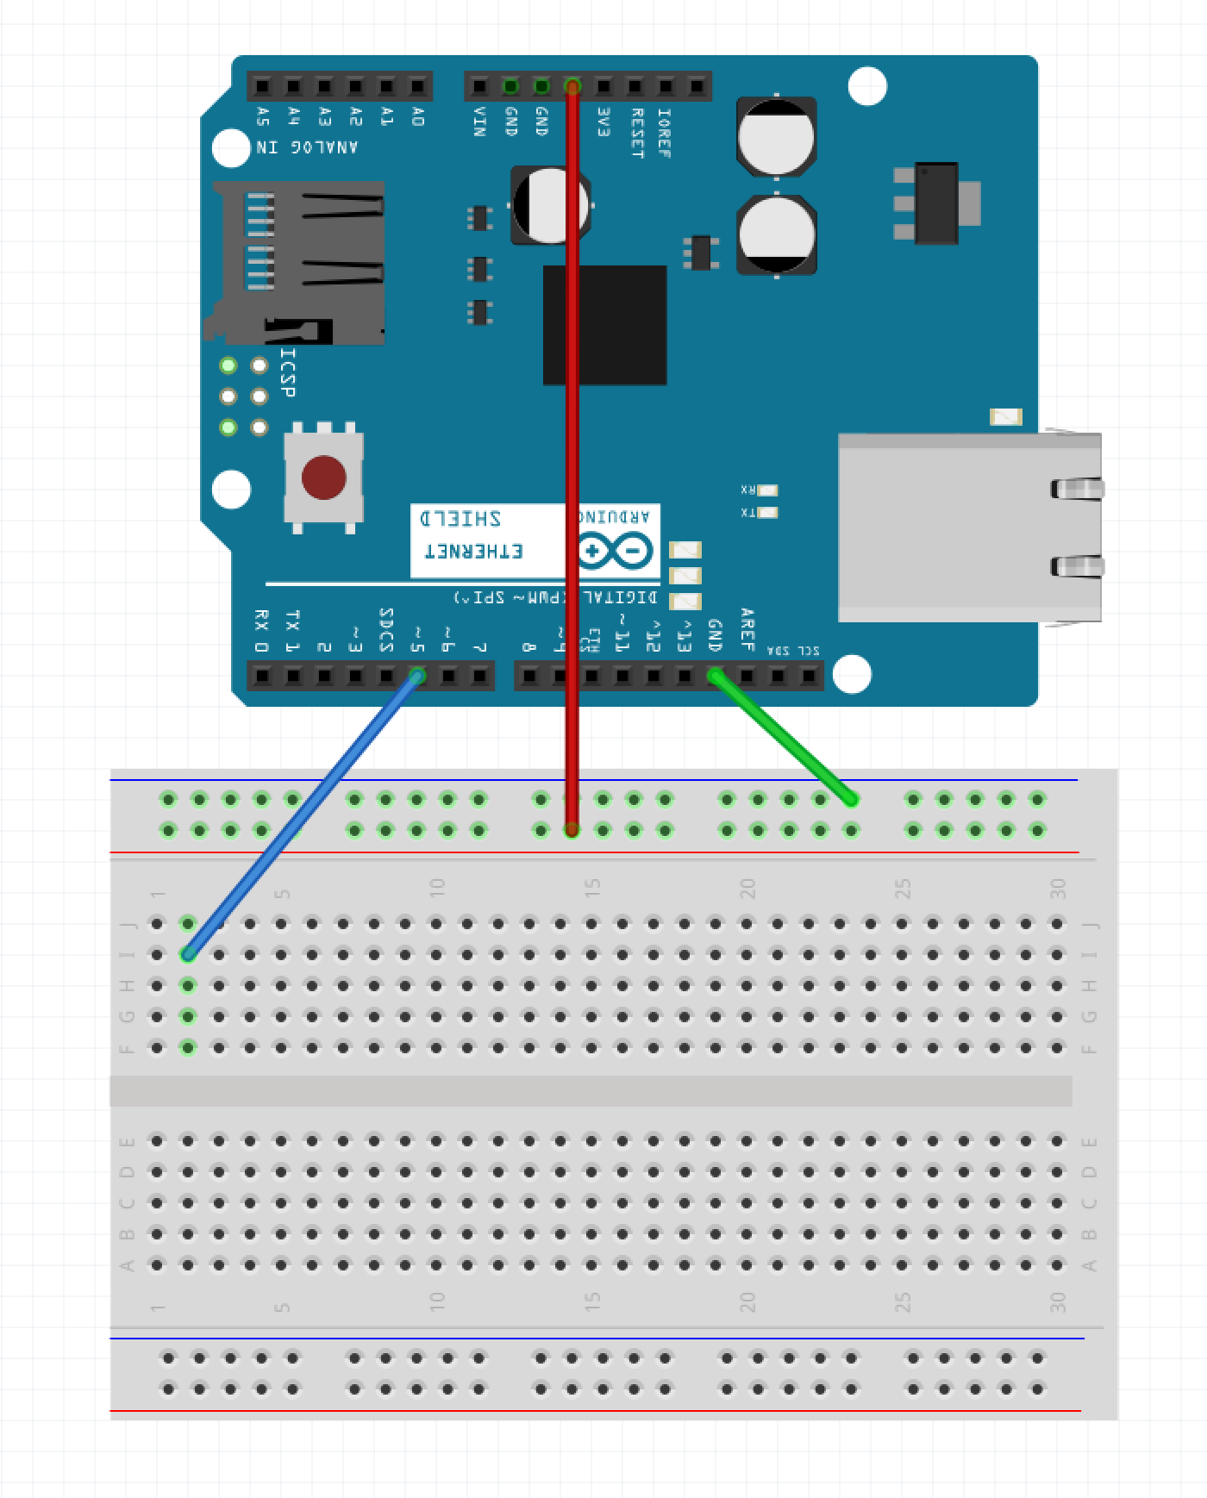
Step 1 – Wire the Rails
Run a wire from GND pin on Arduino to Blue Row on breadboard
Run a wire from 5V pin on Arduino to Red Row on breadboard
Run a wire from pin 5 of the Arduino to I:2

Slide 30
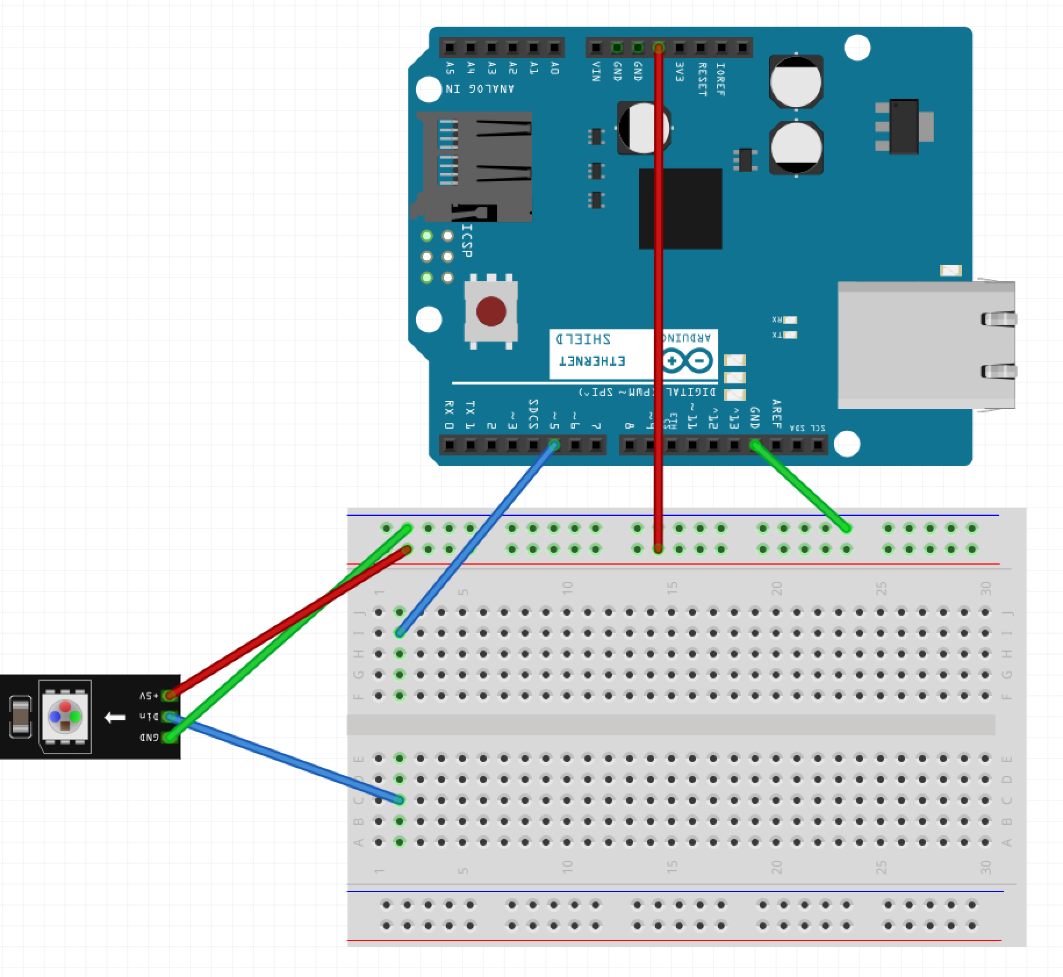
Step 2 – Wire the LED Strip
Run a wire from the Blue Row on breadboard to the GND pin of the LED strip
Run a wire from the Red Row on breadboard to the 5V pin of the LED strip
Run a wire from C:2 to the DIn pin of the LED strip

Slide 31
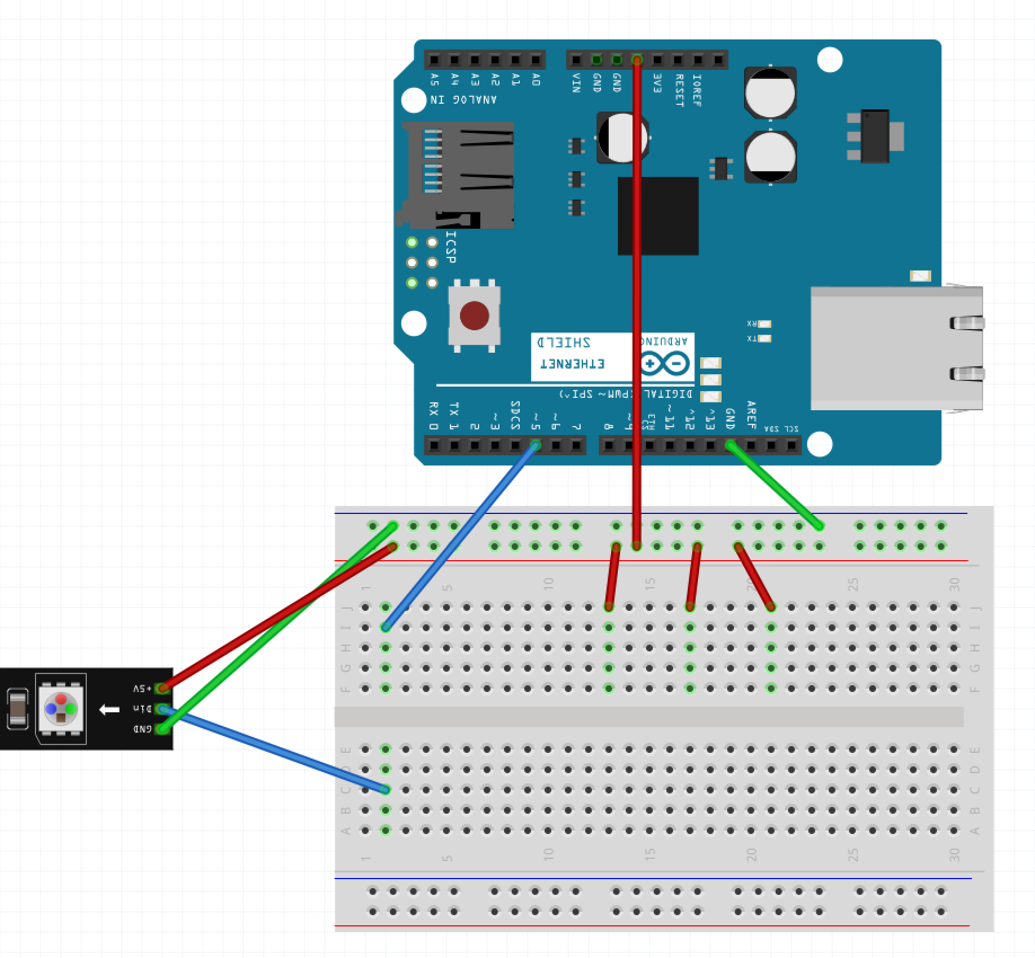
Step 3 – Wire One Side of Button
Run a wire from the Red Row on breadboard to J:13
Run a wire from the Red Row on breadboard to J:17
Run a wire from the Red Row on breadboard to J:21

Slide 32
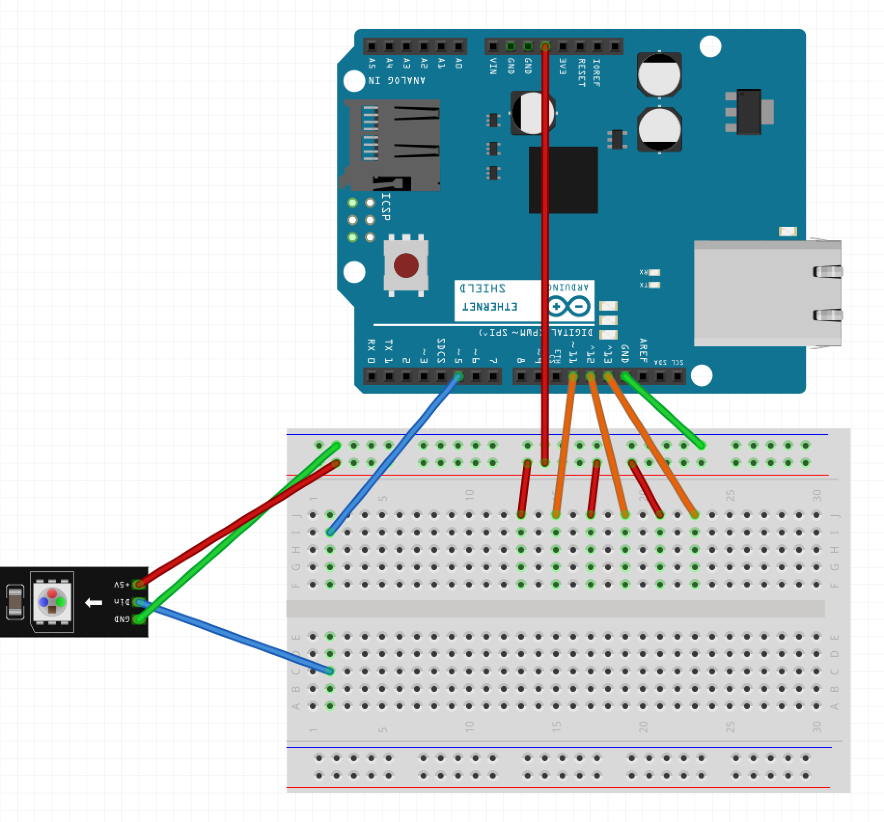
Step 4 – Wire Other Side of Button
Run a wire from pin 11 of the Arudino to J:15
Run a wire from pin 12 of the Arudino to J:19
Run a wire from pin 13 of the Arudino to J:23

Slide 33
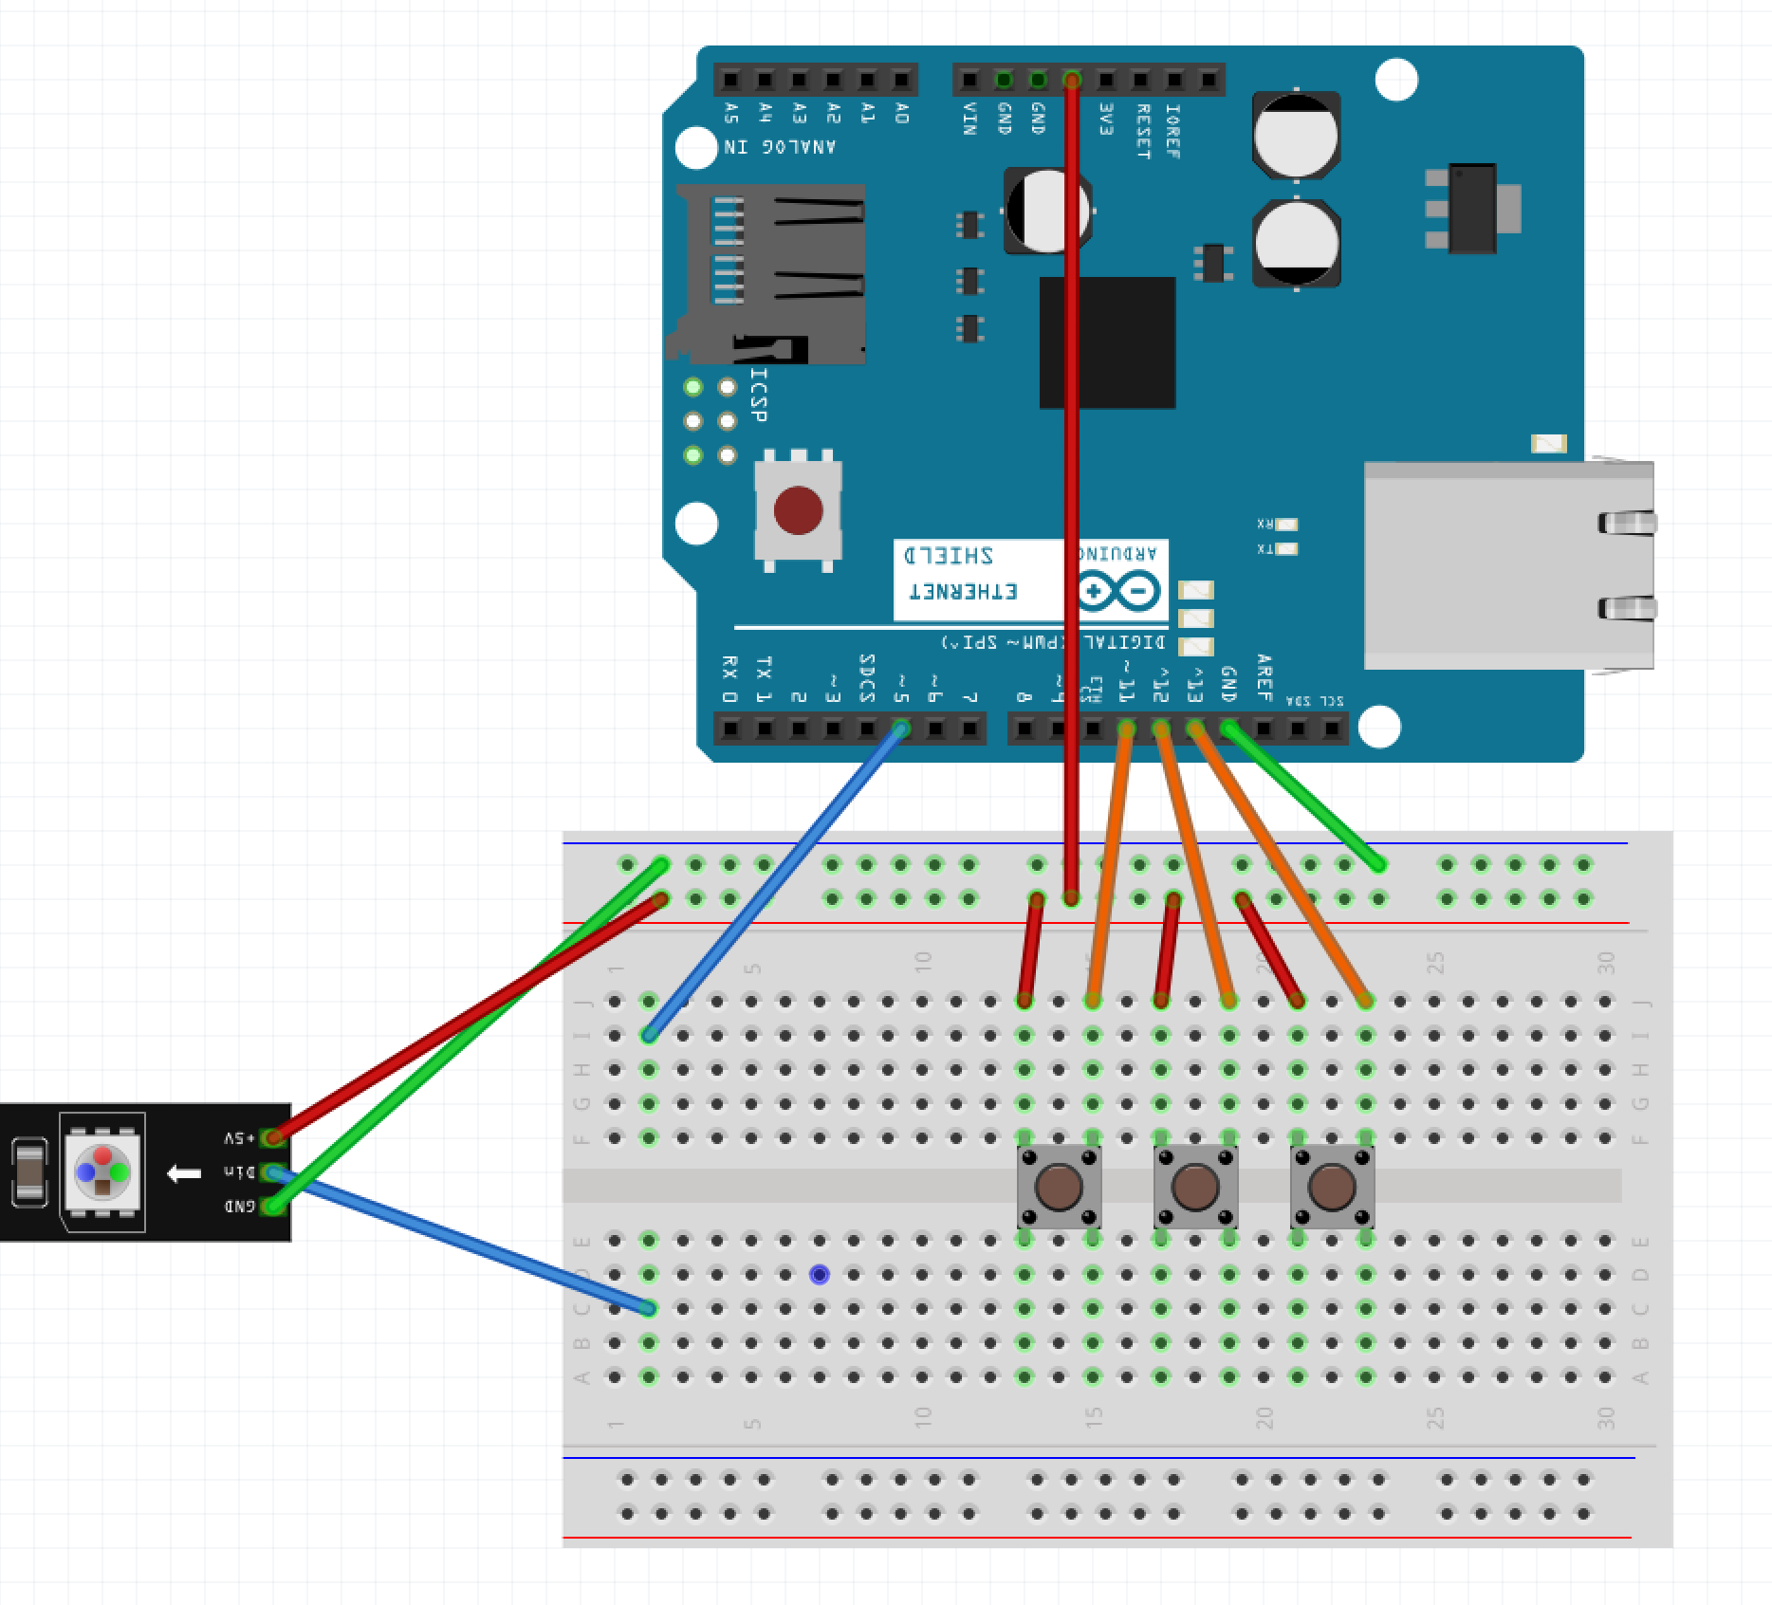
Step 5 – Button Placement
Place the 3 buttons
One in F:13 and F:15
One in F:17 and F:19
One in F:21 and F:23

Slide 34
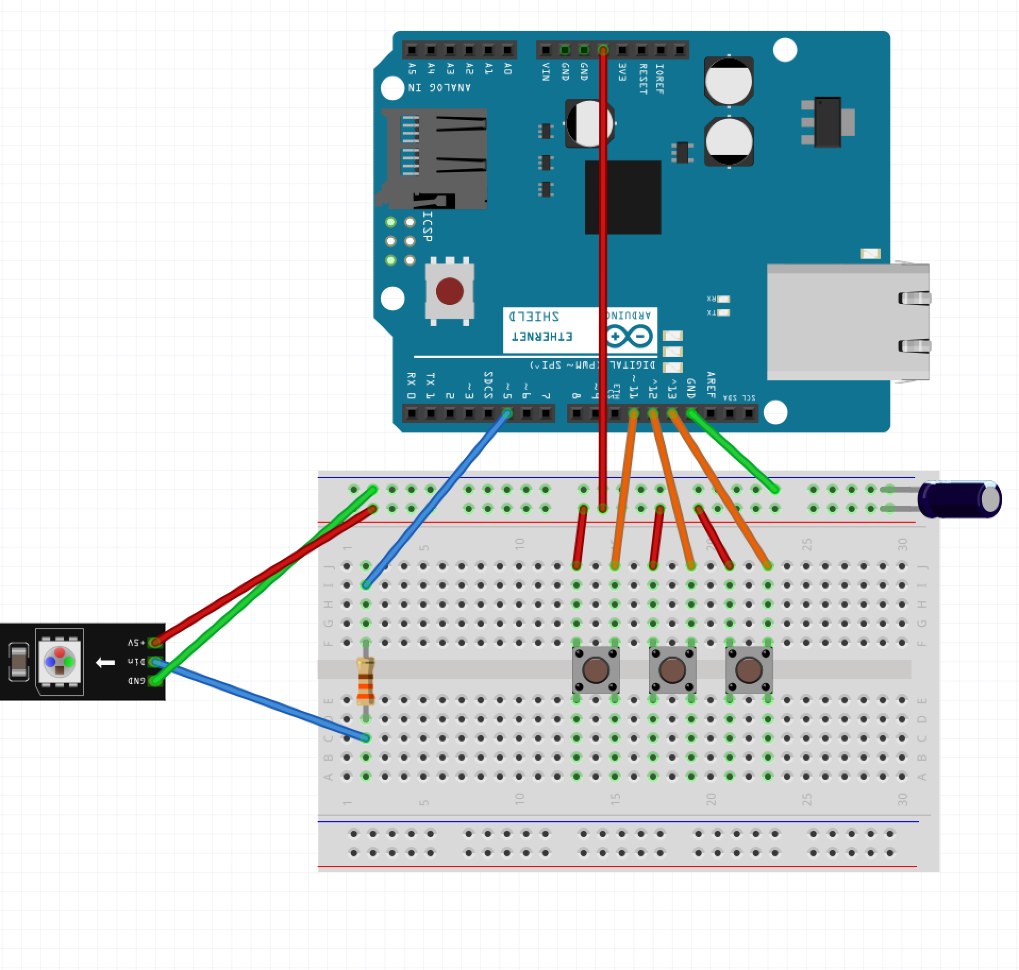
Step 6 – Components
Place the Resistor over the gap on F:2 and D:2
Place the capacitor with the long leg in the Red Row and the short leg in the Blue Row

Slide 35
Step 7 – Power the Arduino
Plug the Arduino into the USB Cable
Plug the USB Cable into the PC

Slide 36
Step 8 – Program the Arduino
Open Sketch button_driven_led.ino
Select Tools -> Port
Click the Upload Button

Slide 37
Putting it All Together
https://youtu.be/ahpPqD7Ju5w?t=17s

